Slide 1
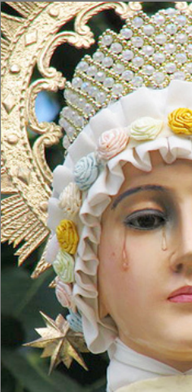
TOTAL CONSECRATION TO
JESUS THROUGH MARY
PRAYER AND REFLECTIONS:
MONDAYS, 7.15 PM,
APRIL 28 – MAY 26th
CONSECRATION DAY:
SATURDAY MAY 31 2014
NATIONAL SHRINE OF
OUR LADY OF LA SALETTE,
947 PARK STREET, ATTLEBORO MA
Tel 508-222-5410
Led by Anna Rae-Kelly, OCDS M.TH. M.Sc

